Slide 1



Sorting Algorithm
Visualizer
Rajkiya Engineering College,
Kannauj
Faculty Adviser: Dr. Vivek Srivastava
Name : SURAJ KUMAR
Roll No: 1883910055
B.Tech : CSE 4th

Slide 2
Objective
* The Main Objective of Sorting Algorithm Visualizer is ,understand algorithms visually ,Because we now A picture is worth of thousands words.

Slide 3
Abstract
*We have learnt sorting algorithms like bubble sort, selection sort, insertion sort, quick sort. But often we fail to understand the core idea of a particular algorithm maybe because we are unable to visualize how they work. So the most important thing to understand about these algorithms is visualization.
That’s why we are making this project to let everyone understand how these algorithms work and through this project I also would get a deep understanding of such sorting algorithms.

Slide 4
Introduction
Currently almost in every educational institutions sorting algorithms are teaches on paper or board there animation is tough, and its consequences are:
Some students looses there interest towards topic
Some stuck in confusion.
Time consuming
Boring
We can make algorithms interesting by visualising them.

Slide 5
Approach
• Creating the website's User Interface (UI) using HTML, CSS and enhancing it further using Bootstrap; without actually implementing any of the app's core features.
• Implementation of animations, effects and core functionalities (sorting algorithms) using JavaScript.

Slide 6
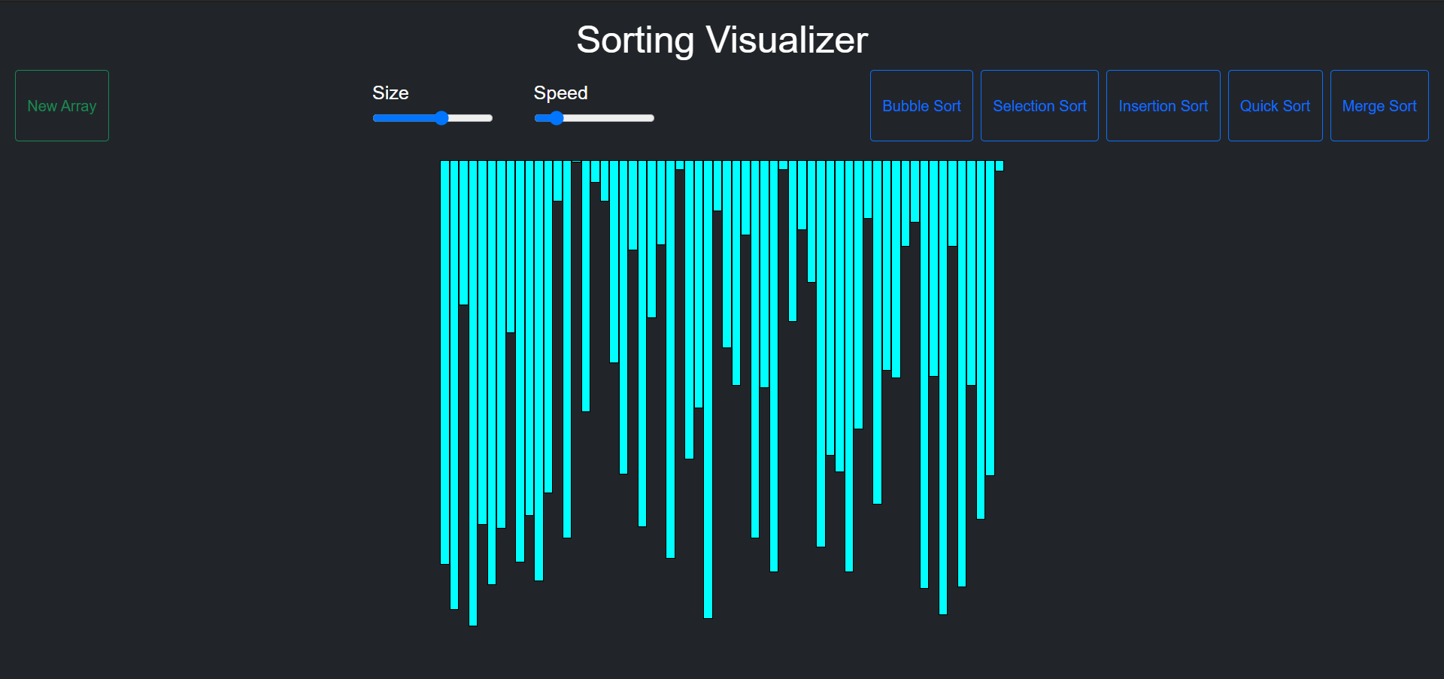
Software Appearance

Slide 7

Software Appearance
Navigation bar

Slide 8
Prerequisite
HTML, CSS, JavaScript
Sorting Algorithms

Slide 9
Thank You

